Slide 1
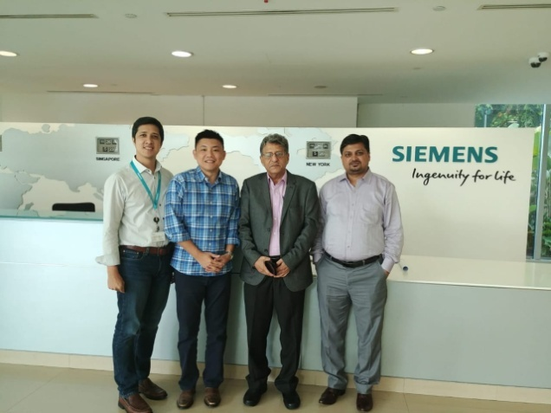
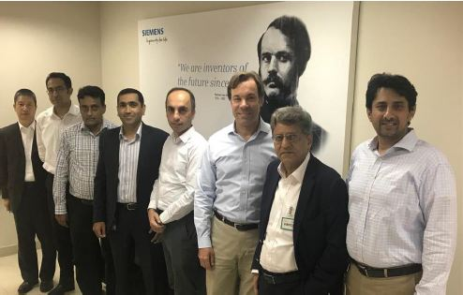
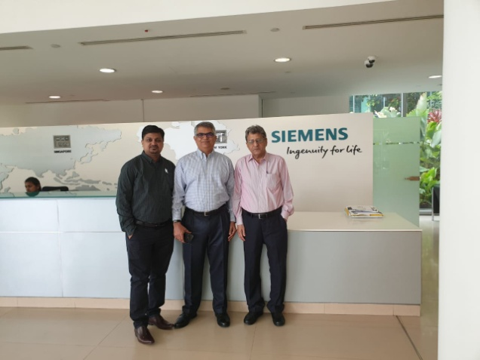
Upcoming era of Academia 4.0
RASTEK and SIEMENS joins hands for the
Marching toward Digitalization of Academia Transformation
IDEATION REALIZATION UTILIZATION
Digitalization change everything including education
Let See -- How ???

Slide 2

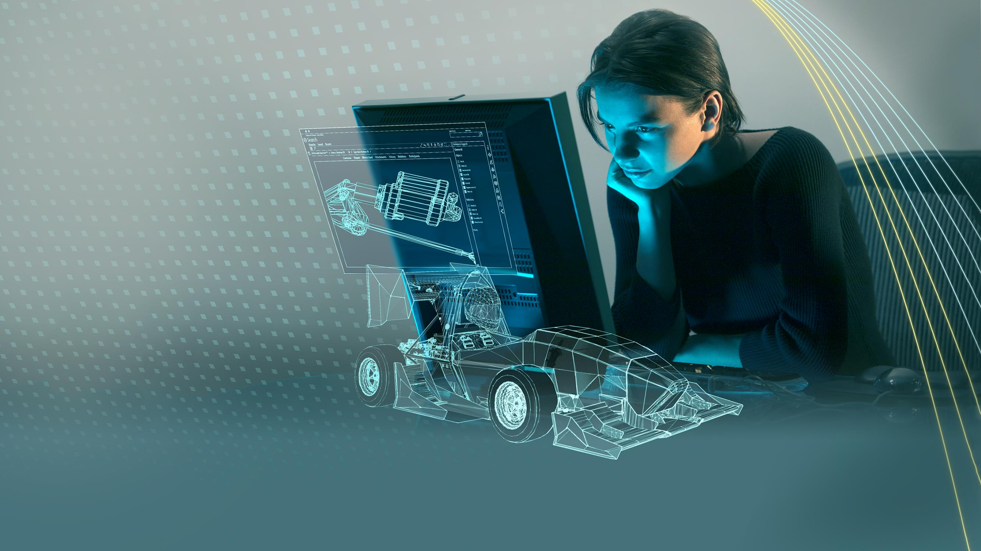





Global Academic Program
Academia 4.0 - Empowering the next generation of digital talent
Unrestricted © Siemens AG 2019 Realize innovation.

Slide 3


Digitalization changes everything.
Unrestricted © Siemens AG 2019
Page 2 May 2019 Siemens Digital Industries Software

Slide 4

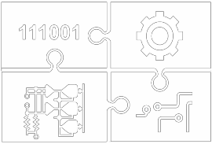

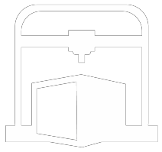


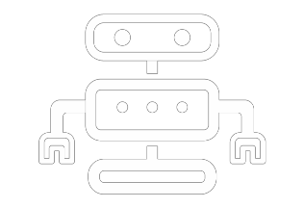
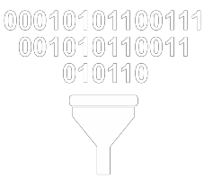
Manufacturers face a disruptive era of innovation Digitalization changes everything
Changing the way products come to life
Changing the way products are realized
Changing the way products evolve
GENERATIVE DESIGN
SYSTEM OF SYSTEMS
MACHINE LEARNING
ADDITIVE MANUFACTURING
CLOUD TECHNOLOGY
KNOWLEDGE AUTOMATION
INTELLIGENT MODELS
ADVANCED ROBOTICS
BIG DATA ANALYTICS
Unrestricted © Siemens AG 2019
Page 4

Slide 5

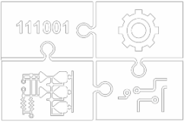
Leverage these forces to transform your education process
IDEATION
REALIZATION
UTILIZATION
Unrestricted © Siemens AG 2019
Page 5

Slide 6





Digitalization changes the workplace
Digital skills are standard requirements,
as are analytics and problem solving
Innovation becomes everyone’s job
Manual labor and routine tasks decline
Analytics dominate
decision making
Birth of the “human
cloud” and guilds
Unrestricted © Siemens AG 2019
Page 6

Slide 7








Supply
Digitalization widens the skills gap
Demand
Millions of worldwide manufacturing jobs unfilled due to a skills
gap
Advanced manufacturing, engineering and computing jobs are growing by double digits
Companies reporting difficulty in filling positions due to a lack
of skills
Sources : World Economic Forum, Change the Equation
Unrestricted © Siemens AG 2019
Page 7

Slide 8
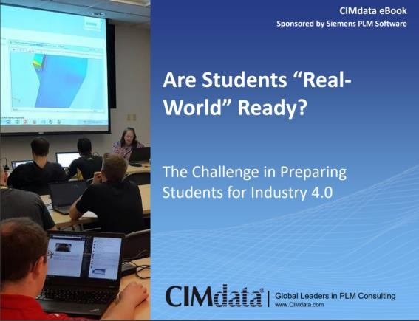
Closing the engineering skills gap State of Academia
PLM TOPICS EDUCATORS MOST WANT TO COVER IN FUTURE COURSES
In order of importance from top to bottom
Design for additive manufacturing
Digital manufacturing
PDM
PLM processes Data analytics Mechanical CAD
Systems engineering or MBSE
MBD or MBE
Data visualization
CAM & NC
Manufacturing planning
CAE
Electrical CAD
ALM
5 most important
4
3
2
1 least important
0
2
4
6
8
10
12
14
16
Unrestricted © Siemens AG 2019
Page 8

Slide 9
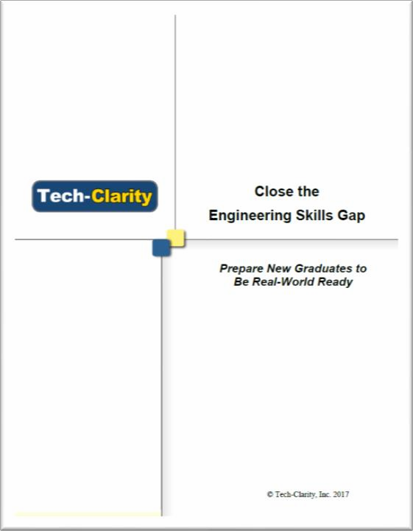
Closing the engineering skills gap State of Engineering
CLOSE THE ENGINEERING SKILLS GAP
Prepare the new graduates to be real-world ready
Product cost management
Manufacturabilty Specifics about my industry Project management
PDM CAM PLM CAE
Problem solving Systems Engineering
Ideation
CAD
66%
65%
61%
53%
52%
51%
51%
46%
46%
45%
44%
41%
0%
10%
20%
30%
40%
50%
60%
70%
Unrestricted © Siemens AG 2019
Page 9

Slide 10

Siemens academic strategic initiative closes the skills gap and empowers the next generation of digital talent
Real-World Competitions
Academic Partner Ecosystem
>3000
Schools
Globally
>140K
Customers
Industrial Strength Software
Best Practice Curriculum
>1
Million Students
Online Training and Resources
Unrestricted © Siemens AG 2019
Page 10

Slide 11

































































Solution Partner Ecosystem
Academic Partners - Global Opportunities in PLM (GO PLM)
3,000 Academic Partners - 1,000,000 Students
AMERICAS EMEA DACH ASIA-PACIFIC
Unrestricted © Siemens AG 2019
Page 10

Slide 12
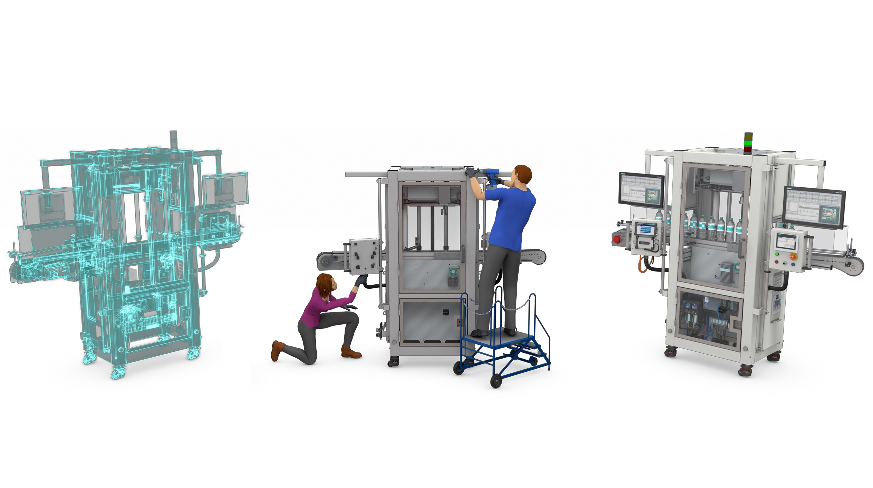
Welcome to the age of ubiquitous innovation
Ideation
Realization
Utilization
Unrestricted © Siemens AG 2019

Slide 13
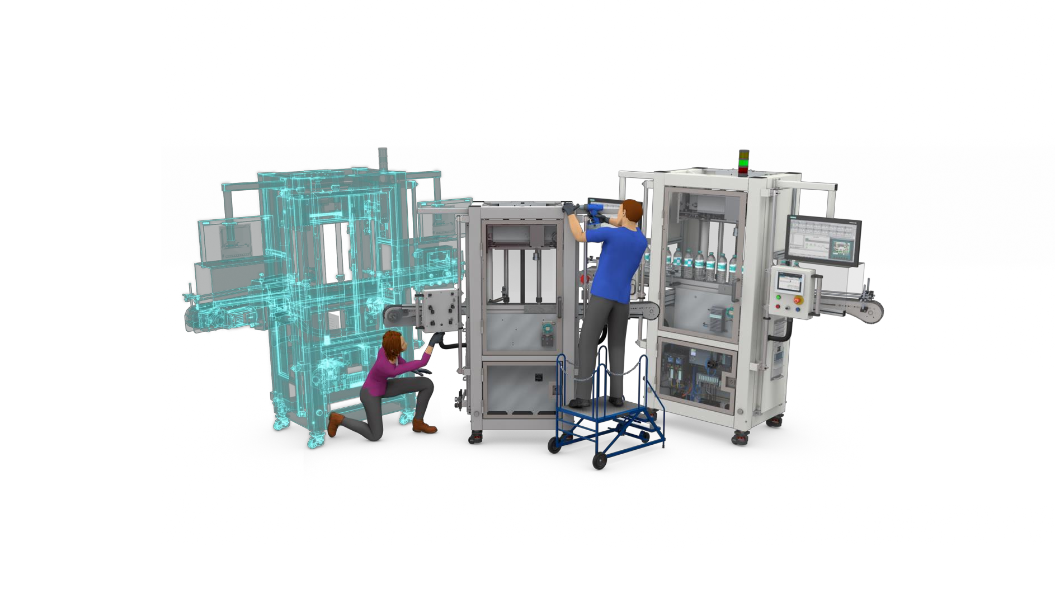


The boundaries between systems are disappearing
Unrestricted © Siemens AG 2019

Slide 14
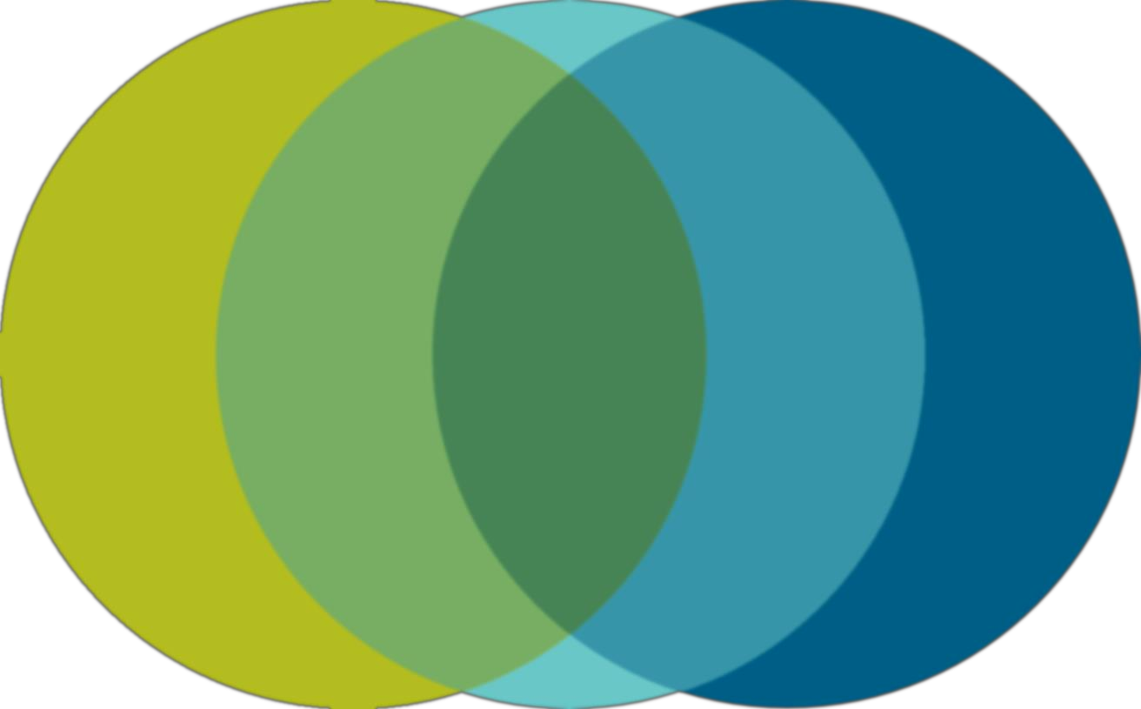
We need to remove the boundaries in engineering education
Simulation
Mechanical
Automation
Electronics
& Electrical
Collaboration
Analytics
Software
Execution
Manufacturing
Unrestricted © Siemens AG 2019

Slide 15

The old rigid labels are dissolving…
Unrestricted © Siemens AG 2019

Slide 16
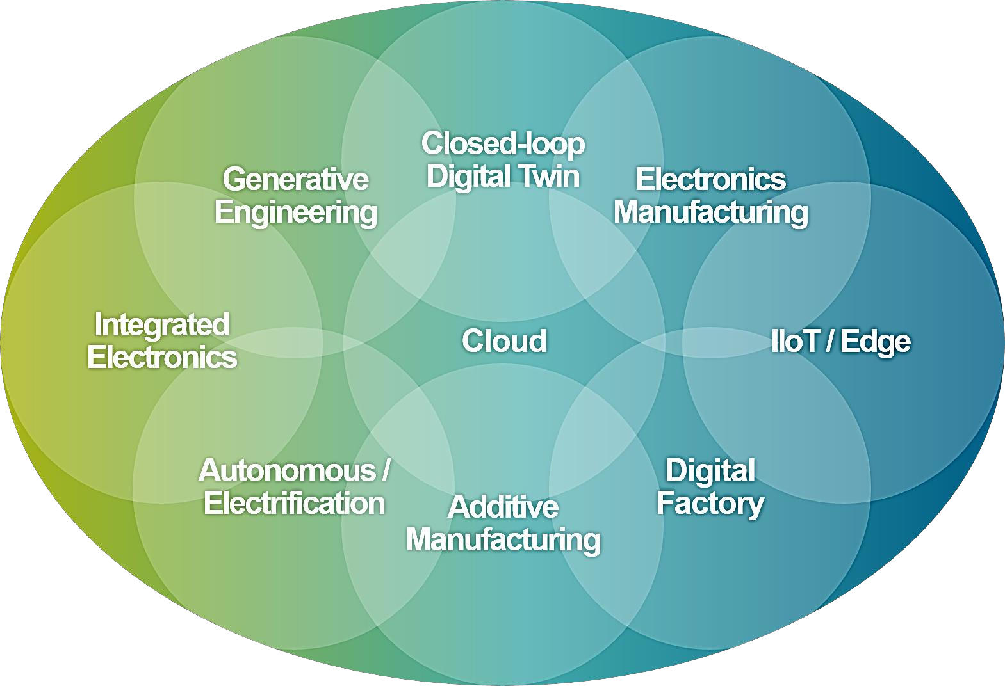
Merging into new, more transformational solutions
Unrestricted © Siemens AG 2019

Slide 17

An innovation platform that becomes second nature
Unrestricted © Siemens AG 2019

Slide 18

Siemens supports major engineering disciplines with software and real-world curriculum
Mechanical
Engineering
NX, Solid Edge, Simcenter, Mentor, Teamcenter, Tecnomatix
Electrical
Engineering
Mentor Xpedition, Mentor PADS Pro, Mentor Capital, Mentor Calibre
Computer
Science
MindSphere, Polarion, Mendix
Engineering
Technology
NX, Solid Edge, Simcenter, Mentor, Teamcenter
Industrial
Engineering
NX CAM, Teamcenter, Tecnomatix, TIA Portal
Aerospace
Engineering
NX, Solid Edge, Simcenter, Mentor, Teamcenter
Automotive Engineering
NX, Solid Edge, Simcenter, Mentor, Teamcenter
Chemical Engineering
Simcenter, Teamcenter Tecnomatix
Marine Engineering
NX, Solid Edge, Simcenter, Teamcenter, Tecnomatix
Unrestricted © Siemens AG 2019

Slide 19
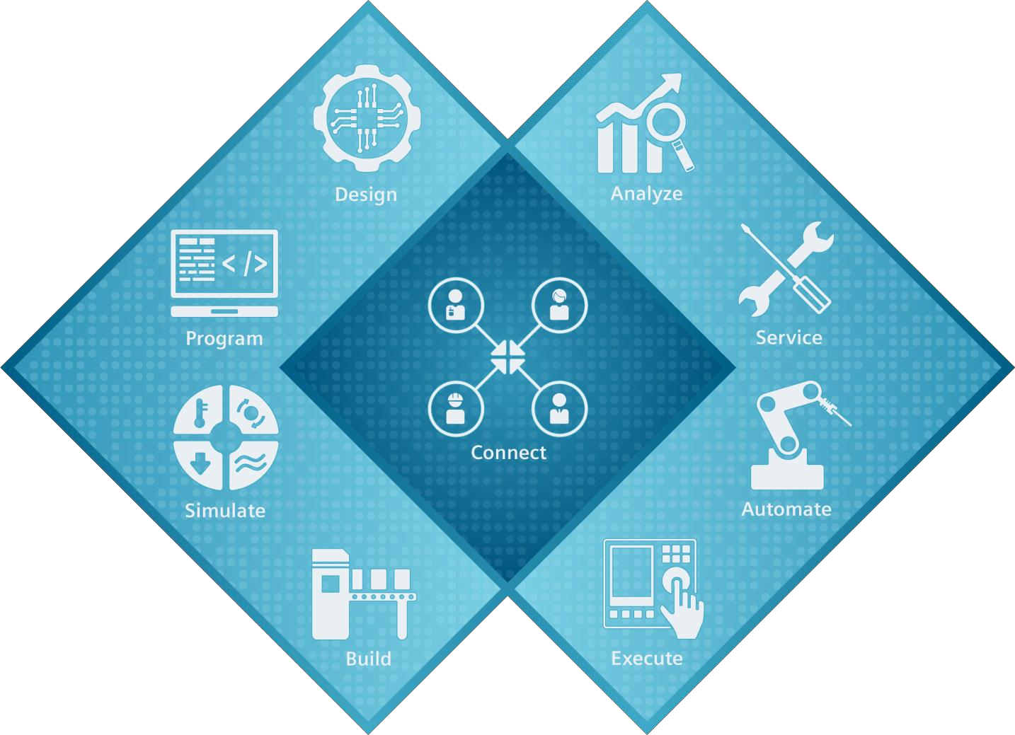
Digital Enterprise Software Suite Domains
DESIGN
ANALYZE
Mindsphere Omneo
NX
Solid Edge Catchbook Fibersim
Syncrofit Mastertrim
PROGRAM
Polarion Application Lifecycle Management
SERVICE
Siemens Digital Services
SIMULATE
NX Nastran Simcenter Imagine.Lab Star-CCM+ Virtual.Lab HEEDS
Test.Lab
AUTOMATE
TIA Portal
SIMATIC SIMOTION SINUMERIK
BUILD
Tecnomatix Intosite NX CAM Line Designer
EXECUTE
SIMATIC IT Preactor
IBS QMS Production
WinCC Systems
Camstar Engineering
CONNECT
Teamcenter
Unrestricted © Siemens AG 2019

Slide 20
GA Tech – Typical Mechanical Engineering Curriculum
Freshman | Fall | CHEM 1310 |  | MATH 1501 |  |  |  |  |  | ENGL 1101
 |  | General Chemistry (See No te 2) 3-3-4 |  | Calculus 1 (M inimum Grade C) 4-0-4 |  | US Perspective HIST 2111, HIST 2112, POL 1101, INTA 1200, or PUBP 3000 [ Social Science ] 3-0-3 |  | Wellness APPH 1040, APPH 1050 or HPS 1040 2-0-2 |  | English Composition 1 3-0-3
 | Spring | PHYS 2211 |  | MATH 1502 |  | CS 1371 |  | ME/CEE 1770 |  | ENGL 1102
 |  | Physics 1 |  | Calculus 2 (M inimum Grade C) |  | Introduction to Computing |  | Engineering Graphics |  | English Composition 2
 |  | 3-3-4 |  | 4-0-4 |  |  |  | (See No te 3, No W's) |  | 3-0-3
 |  | M ATH 1501 |  | M ATH 1501 |  | 3-0-3 |  | 2-3-3 |  | ENGL 1101
Sophomore | Fall | PHYS 2212 |  | MATH 2401 |  | ME 2110 Creative Decisions and Design (See No te 3, No W's) 2-3-3 |  | MSE 2001 Engineering Materials 3-0-3 |  | COE 2001 Statics 2-0-2
 |  | Physics 2 |  | Calculus 3
 |  |  |  | (M inimum Grade C)
 |  | 3-3-4 |  | 4-0-4
 |  | PHYS 2211 |  | M ATH 1502 |  | M E/ CEE 1770, COE 2001* |  | CHEM 1310 |  | M ATH 1502, PHYS 2211
 | Spring | ECE 3710 |  | MATH 2403 Differential Equations (M inimum Grade C) 4-0-4 |  | ME 2202 Dynamics of Rigid Bodies 3-0-3 |  | ME 2016 Computing Techniques 3-0-3 |  | Science Elective B IOL 1510, B IOL 1520, EA S 1600, EA S 1601o r P HYS 2213 (See Not e 7) X-X-3
 |  | Circuits &
 |  | Electronics
 |  | 2-0-2
 |  | PHYS 2212 |  | M ATH 1502 |  | COE 2001 |  | CS 1371, M ATH 1502,
 |  |  |  |  |  |  |  | M ATH 2403*
Junior | Fall | ECE 3741 |  | COE 3001 Mechanics of Deformable Bodies 3-0-3 |  | ME 3322 |  | ME 3340 |  | Economics ECON 2100, 2101, 2105, o r 2106 (See Not e 5) 3-0-3
 |  | Instrument & |  |  |  | Thermo- |  | Fluid
 |  | Electronics Lab |  |  |  | dynamics |  | Mechanics
 |  | 0-3-1 |  |  |  | 3-0-3 |  | 3-0-3
 |  | ECE 3710 |  | COE 2001, |  | PHYS 2211, M ATH 2403 |  | M E 2202, M ATH 2403
 |  |  |  | M ATH 2403* |  |  |  | M ATH 2401, M E 3322*
 | Spring | ME 3017 |  | ME 3345 Heat Transfer 3-0-3 |  | MATH 3670 |  | ISYE 3025
 |  | System Dynamics |  |  |  | Statistics (ISYE 3770 is also accepted) |  | Engineering Economics |  | Social Science Elective
 |  | 3-0-3 |  |  |  | 3-0-3 |  | 1-0-1 |  | (See No te 6)
 |  | M E 2202, M E 2016, M ATH 2403, ECE 3710 |  | M E 3322, M E 3340, M ATH 2403 |  | M ATH 2401 |  | (ECON 2100, 2101, 2105 or 2106) |  | 3-0-3
Senior | Fall | Design Elective |  | ME 3210 Design, Materials & Manufacture 3-0-3 |  | ME 3057 Experimental Methods Lab (See No te 3, No W's) 2-3-3 |  | ME Elective 3000 Level or Above ME Class (See No te 4) 3-0-3 |  | Free Elective 2000 Level or Above (See No te 1) 3-0-3
 |  | ME 3180 or ME 4315
 |  | 3180: M achine Design
 |  | 4315: Energy Sys Design
 |  | 3-0-3
 |  | M E 2110, |  |  |  | COE 3001, M E 3340,
 |  | M E 3345( f or ME4315 only) , |  | M SE 2001, M E 2110 |  | M E 3017*, M E 3345*,
 |  | COE 3001( f or ME3180 only) |  |  |  | M ATH 3670*
 | Spring | ME 4056 ME Systems Lab (See No te 3, No W's) |  | ME 4182 Capstone Design (See No te 3, No W's) |  | ME Elective 3000 Level or Above ME Class |  | Social Science Elective |  | Free Elective 2000 Level or Above
 |  | 2-3-3 |  | 1-6-3 |  | (See No te 4) |  | (See No te 6) |  | (See No te 1)
 |  | M E 3057, M E 3345, M E 3017, M ATH 3670 |  | COE 3001, M E 3345, M E2110, M E3210, M E3017, M ATH 3670, Design Elect . |  | 3-0-3 |  | 3-0-3 |  | 3-0-3
Unrestricted © Siemens AG 2019

Slide 21
Example Offering
Products
NX CAD/CAM, Simcenter 3D, Teamcenter Unified
Training
Learning Advantage e-learning portal providing free, self-paced, full coverage training for educators
Industry 4.0 Laboratory
Including Siemens hardware and software product workflow
Technical Assistance
Major and minor software releases, telephone- and web-based technical support
Curriculum
NX10 for Engineering Design by Ming C. Leu (Missouri University of Science and Technolgy)
Competitions
Formula Student: Global student engineering competition reaching thousands of students who build, test, race a small-scale formula race car. Three year ramp up to full involvement
Unrestricted © Siemens AG 2019

Slide 22
Sample Curriculum and Tutorials for Academic Partners
Curriculum
Lessons and Tutorials
Self-paced Learning
More than 4000 courses
Composite Design
Automotive Cooling
Mechanical Design
Model-Based Systems Engineering
Mechanics of a Simple Pendulum
Simulation
Introduction to PDM
Hydraulics
Plant Simulation
PLM
Additive Manufacturing
Product Data Management
Engineering Design
Following the Digital Thread
Advanced Simulation
FEA Analysis
Sample Data Sets
Unrestricted © Siemens AG 2019

Slide 23

Learning Resources
Software Learning Resources for academic partners
Benefits
24x7 Self-Paced learning
Broad Product Coverage
Free for Educators, Academic Partners and Students
Instructor-Led Classes*
Siemens Learning Resources provide
convenient, easy to use e-Learning content that
enables users to gain skills and knowledge in
Siemens software products
Topics include:
Additive Manufacturing
Product Lifecycle Management
Model-Based Systems Engineering
Manufacturing and Automation
* Availble for on a service-basis
Unrestricted © Siemens AG 2019

Slide 24



Real-world competitions
A sample of Siemens sponsorships
SAE Aero
2 Aerospace competitions in the
U.S. ~150 teams with ~2,000 students. Three classes of remote control airplanes compete on design merits and flight mission accomplishments.
EcoCAR 4
Partnership with GM and U.S. Dept. Energy. 12 universities in 4 year competition to re-engineer GM Blazer SUV into a hybrid-EV with connected and autonomous car upgrades.
FIRST® Robotics Competition 3850 teams, comprising more than 90K students, aged 14-18, design and develop robots over a 6 week sprint. They also work on project management, fundraising and presentation skills.
Formula Student
Global university competition, 550 universities, ~20,000 students who design, build and compete on design merits and on track.
Formula race car classes: petrol,
electric and even autonomous.
Greenpower
Global elementary-university competition reaching more than 50,000 students who design, build and race electric cars. Teams also work on presentation, fundraising, and teambuilding.
ASME E-Fest Events Annual event includes multiple competitions: gobal contest w/GrabCad; 4 local human powered vehicle, 4 robotics competitions and 1 Additive Manufacturing competition.
Unrestricted © Siemens AG 2019

Slide 25
Universities in South East Asia with close Siemens cooperation
Thailand
King Mongkut’s University of Technology
Vietnam
Hanoi University of Science and Technology Industrial University of Ho Chi Minh City
Ho Chi Minh City University of Technology
Indonesia
Sepuluh Nopember Institute of Technology
Malaysia
Universiti Teknologi MARA Universiti Science Malaysia UniKL
UTM Johor
Singapore
National University of Singapore Nanyang Technological University Singapore Institute of Technology
Singapore Polytechnic
Unrestricted © Siemens AG 2019

Slide 26
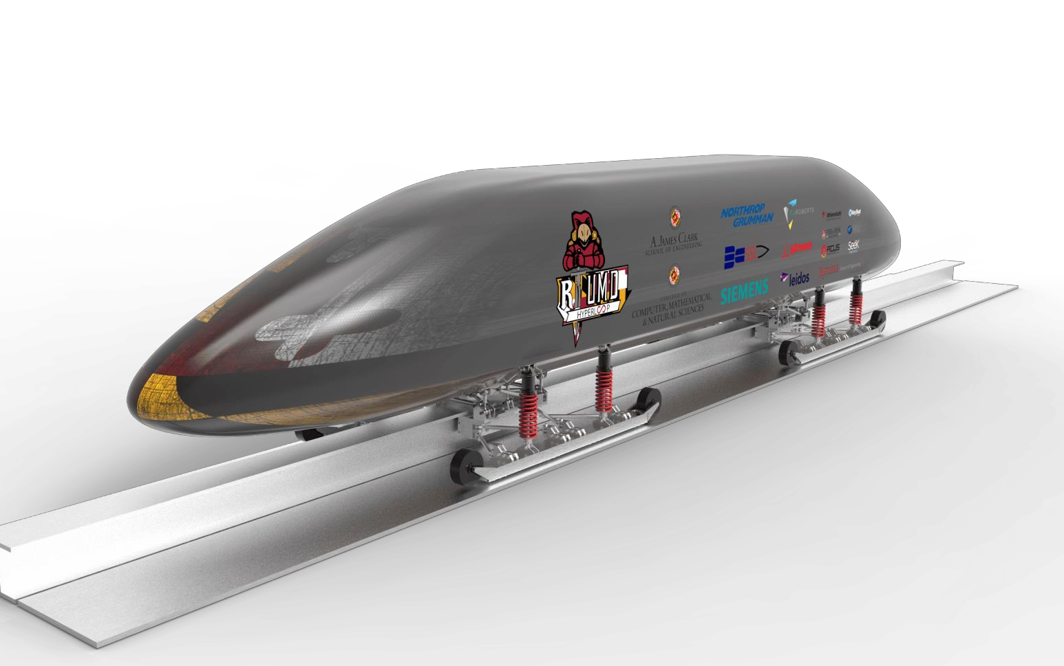
Case Studies
University of Maryland
>1,000 NX seats used in Mechanical, Aerospace, & Systems Research
PLM implemented across campus with 1,000 Teamcenter seats, plus 660 Tecnomatix and 300 Solid Edge seats
Hyperloop competition uses NX, LMS
Terps Racing Team uses NX, Teamcenter & Tecnomatix
AUVSI Robo Sub competition uses NX
Unrestricted © Siemens AG 2019

Slide 27
“The Siemens PLM software grant has had a substantial and growing impact on our teaching, competitions and research. It has enabled us to integrate state-of-the-art CAD/PLM capabilities into our mechanical and aerospace engineering curricula. It has helped our students to learn an industry-leading tool which aids them in their post-graduation careers. The students are
well equipped with CAD and FEA skills, ready for their future employment.
Further, it has helped the Clark School to become more renowned as a leader in the advanced and additive manufacturing revolution.”
Jim Zahniser, Executive Director, Engineering Information Technology
Unrestricted © Siemens AG 2019

Slide 28
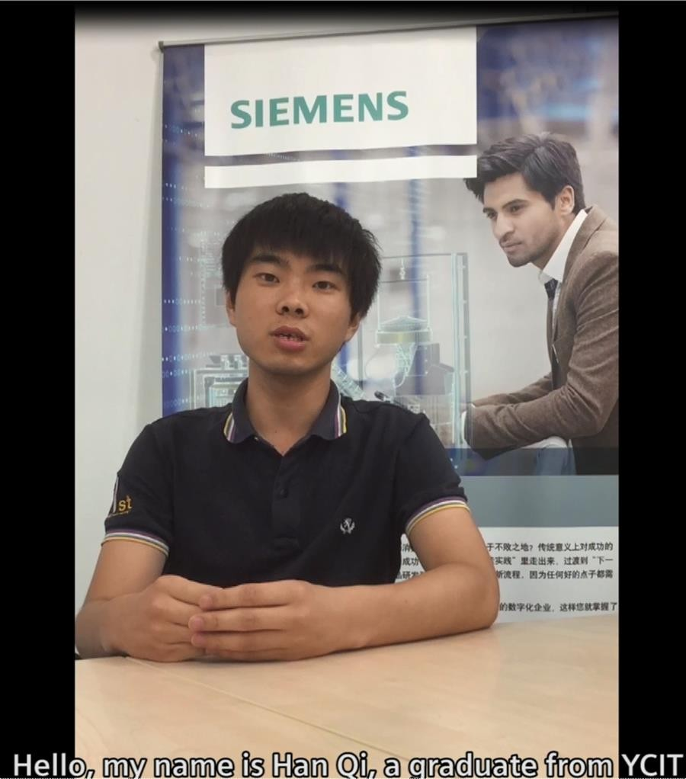
Case Studies
Yancheng Institute of Technology (YCIT)
11th anniversary of Siemens-YCIT partnership developing a stronger pipeline of engineering and digital manufacturing talent
NX and Teamcenter used in standard coursework
Part of the Educational Ecosystem to improve student career readiness through published textbooks and curricula tp train students for certification, internships and recruitment
Unrestricted © Siemens AG 2019

Slide 29

“I learned NX in my freshman year and Teamcenter in my third year. I enjoyed using the software so much, that these courses led to join UGITC, a high-tech consulting services company. I am so proud of my first formal job.”
HanQi, graduate
Yancheng Institute of Technology
Unrestricted © Siemens AG 2019

Slide 30
The Next Steps
Application & Agreement
Grant application form
Curriculum mapping & domain scope
Identify suitable products
Identify services partner
Obtain licenses
Implementation
Software and hardware installation
Customization (if required)
Instructor-led training
Learning Advantage self-training
Curriculum integration
Additional services
Unrestricted © Siemens AG 2019

Slide 31

Together we can empower the next generation of engineers.
Unrestricted © Siemens AG 2019
Page 32 May 2019 Siemens Digital Industries Software

Slide 32


Zain Shirazi
Regional Manager (NORTH)
zain@rastek.com
Sean Seneviratne
Mahesh Kumar
Regional Manager (SOUTH)
mahesh@rastek.com
Academic Programs Manager
Global Academic Partner Program
Sean.seneviratne@siemens.com

